Slide 1
Machine Learning CA1 26 November 2023
Zygimantas Jakubauskas
Miroslava Slavikova

Slide 2
Key Steps of the Project
Selection of the Data set
Exploratory data analysis
Data preparation
Machine learning models
Timeline
Conclusion

Slide 3
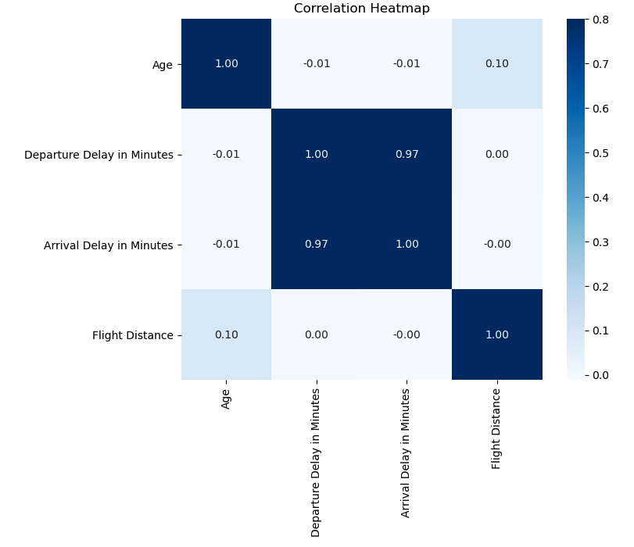
Correlation Heatmap Strong relationship between the "Arrival Delay in Minutes" and "Departure Delay in Minutes".

Slide 4
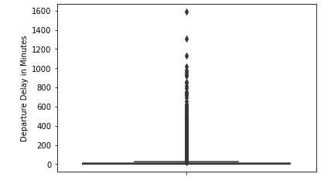
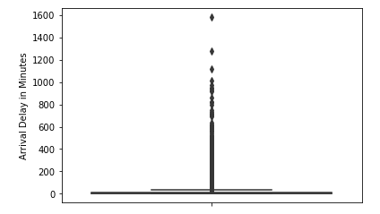
Exploratory Data Analysis using boxplots

Slide 5
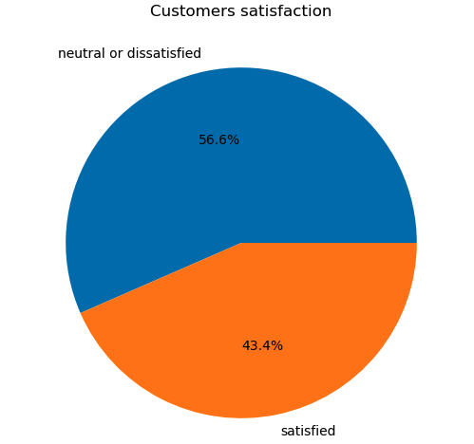
Data Preparation Pie chart displays distribution of “satisfaction” value

Slide 6
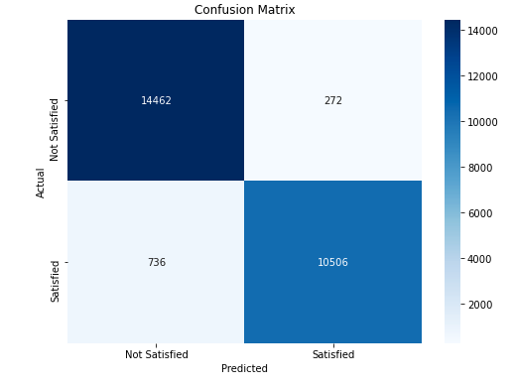
Confusion Matrix – Random Forest model Best performing at 0.2 test size

Slide 7
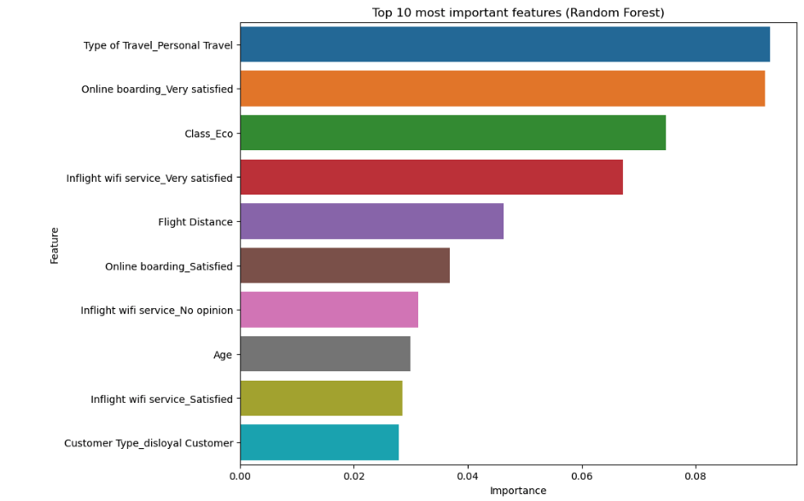
Top 10 most important features using Random Forest model

Slide 8
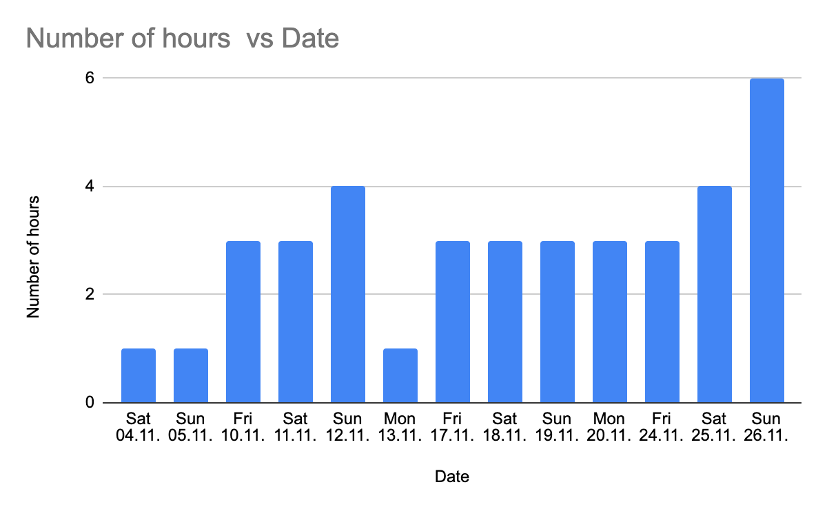
Time Spent on the Project for Miroslava

Slide 9
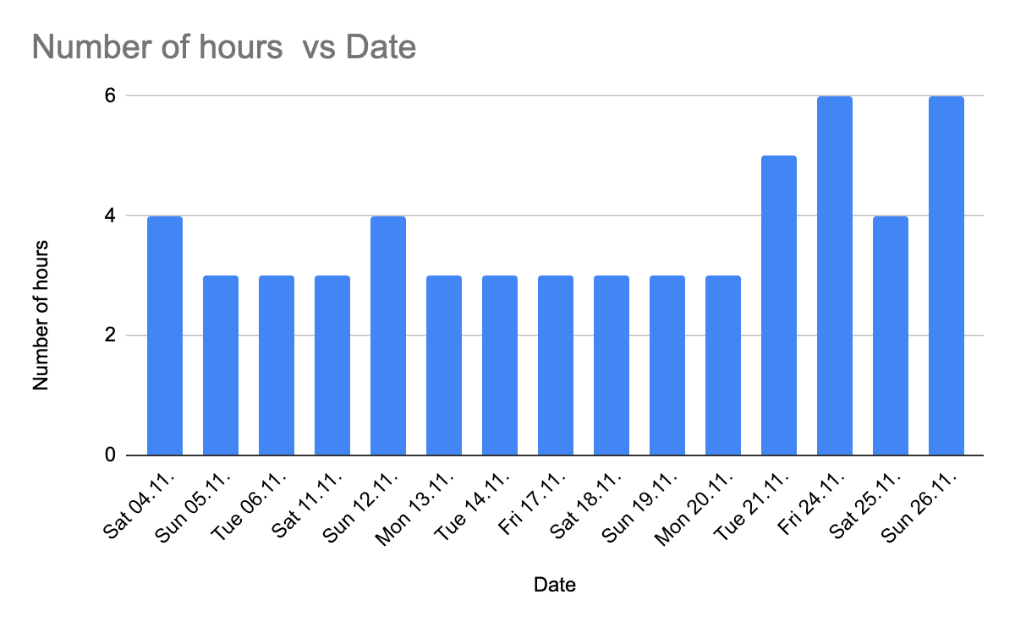
Time Spent on the Project for Zygimantas

Slide 10
Slide Title
Conclusion
Good team work can enhance the project outcome:
Identifying the member’s strengths improves productivity
Sharing ideas boosts creativity
Learning from each other’s experiences improves knowledge
Rectifying problems together strengthen problem solving skills

Slide 11
Thank you.

